Slide 1

Hunting Right Career Path
Prepared By:
Nirali, Pankti, Tanvi
Guided By:
Manvi Mehta

Slide 2
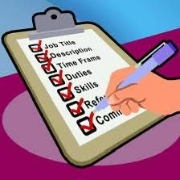
Contents
Why IT field ?
Why Manual Testing Course ?
Job Description
Skills Required

Slide 3

Why “it” field ?
IT sector is one of the fastest growing sector world wide.
The common goal between them is to use technology systems to solve problems and handle information.
IT involves the gathering, sorting, analysis, storage and transmission of any and all types of information using computers.

Slide 4

This field offers too many opportunities for growth innovation and impact.
High demand or increasing demand
Innovative
Global Opportunities
Competitive Salaries
Remote Work
Impactful Work
Multiple Career options
Challenging Work environment

Slide 5
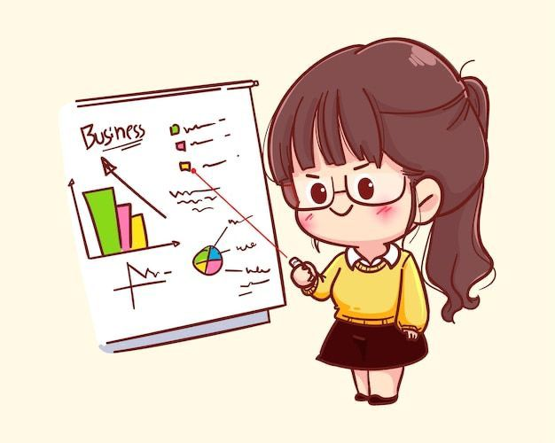
Scope in IT field :
Software Developer
Mobile Application Developer
Cybersecurity Expert
Data Manager
Software Tester

Slide 6
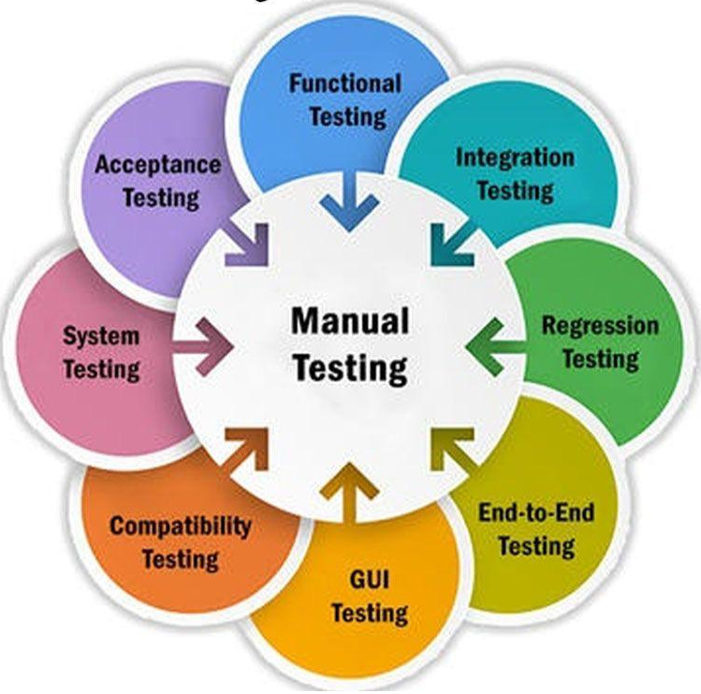
Why Manual Testing Course ?
Manual testing process.
The primary goal of manual testing is to find problems, faults, and flaws.

Slide 7

Choosing a manual testing course can be beneficial for several reasons:
Foundational Knowledge
Practical Experience
Entry Level Opportunities
Complement to Automation
Flexibility and Adaptability
Real User Experience
Better Understanding of Customer Needs

Slide 8
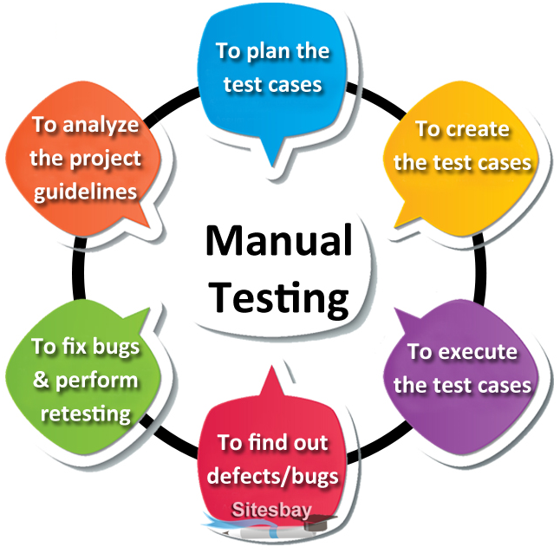
Job Description

Slide 9

Tester Duties and Responsibilities :
Analyze Specifications
Develop Testing
Execute Tests
Document Bugs
Troubleshoot Issues
Retest Software
Enhance Quality

Slide 10
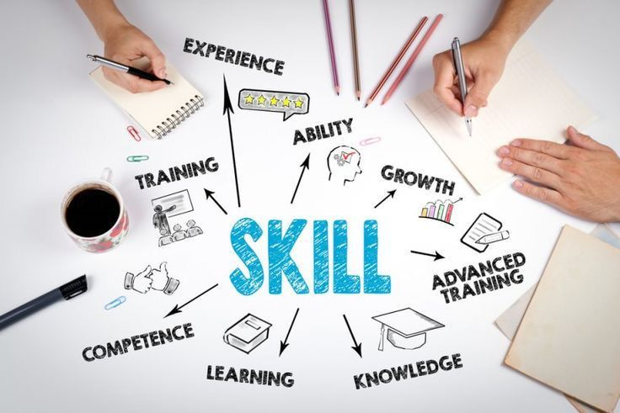
Skills Required
Analytical Skills
Communication Skills
Project Management
Documentation
Technical Skills
Defect Management

Slide 11

Question
Who came first ?
A tester
A Bug

Slide 12

THANK YOU
THANK YOU

